Slide 1
Introduction to PL/SQL

Slide 2
Objectives
After completing this lesson, you should be able to do the following:
  Explain the need for PL/SQL
  Explain the benefits of PL/SQL
  Identify the different types of PL/SQL blocks
  Use Oracle SQL Developer as a development environment for PL/SQL
  Output messages from PL/SQL
Notes:
Oracle Database 10g: PL/SQL Fundamentals 1 - <number>
Lesson Aim
This lesson introduces PL/SQL and PL/SQL programming constructs. You learn about the benefits of PL/SQL. You also learn to use Oracle SQL Developer as a development environment for PL/SQL.

Slide 3





What Is PL/SQL?
PL/SQL:
  Stands for Procedural Language extension to SQL
  Is Oracle Corporation’s standard data access language for relational databases
  Seamlessly integrates procedural constructs with SQL
Notes:
Oracle Database 10g: PL/SQL Fundamentals 1 - <number>
What Is PL/SQL?
Structured Query Language (SQL) is the primary language used to access and modify data in relational databases. There are only a few SQL commands, so you can easily learn and use them. Consider an example:
SELECT first_name, department_id, salary FROM employees;
The SQL statement shown above is simple and straightforward. However, if you want to alter any data that is retrieved in a conditional manner, you soon encounter the limitations of SQL.
Consider a slightly modified problem statement: For every employee retrieved, check the department_id and the salary. Depending on the department’s performance and also the employee’s salary, you may want to provide varying bonuses to the employees.
Looking at the problem, you know that you have to execute the preceding SQL statement, collect the data, and apply logic to the data. One solution is to write a SQL statement for each department to give bonuses to the employees in that department. Remember that you also have to check the salary component before deciding the bonus amount. This makes it a little complicated. You now feel that it would be much easier if you had conditional statements. PL/SQL is designed to meet such requirements. It provides a programming extension to already-existing SQL.

Slide 4
About PL/SQL
PL/SQL:
  Provides a block structure for executable units of code. Maintenance of code is made easier with such a well-defined structure.
  Provides procedural constructs such as:
    Variables, constants, and types
    Control structures such as conditional statements and loops
    Reusable program units that are written once and executed many times
Notes:
Oracle Database 10g: PL/SQL Fundamentals 1 - <number>
About PL/SQL
PL/SQL defines a block structure for writing code. Maintaining and debugging the code is made easier with such a structure. One can easily understand the flow and execution of the program unit.
PL/SQL offers modern software engineering features such as data encapsulation, exception handling, information hiding, and object orientation. It brings state-of-the-art programming to the Oracle server and toolset. PL/SQL provides all the procedural constructs that are available in any third-generation language (3GL).

Slide 5

PL/SQL Environment
PL/SQL engine
procedural
Procedural
Statement
Executor
PL/SQL
Block
SQL
SQL Statement
Executor
Oracle Database Server
Notes:
Oracle Database 10g: PL/SQL Fundamentals 1 - <number>
PL/SQL Environment
The slide shows the PL/SQL execution environment in the Oracle Database server. A PL/SQL block contains procedural statements and SQL statements. When you submit the PL/SQL block to the server, the PL/SQL engine first parses the block. The PL/SQL engine identifies the procedural statements and SQL statements. It passes the procedural statements to the procedural statement executor and passes the SQL statements to the SQL statement executor individually.
The diagram in the slide shows the PL/SQL engine within the database server. The Oracle application development tools can also contain a PL/SQL engine. The tool passes the blocks to its local PL/SQL engine. Therefore, all procedural statements are executed locally and only the SQL statements are executed in the database. The engine used depends on where the PL/SQL block is being invoked from.

Slide 6


Benefits of PL/SQL
  Integration of procedural constructs with SQL
  Improved performance
SQL 1
SQL 2
…
SQL
IF...THEN
SQL
ELSE
SQL
END IF;
SQL
Notes:
Oracle Database 10g: PL/SQL Fundamentals 1 - <number>
Benefits of PL/SQL
Integration of procedural constructs with SQL: The most important advantage of PL/SQL is the integration of procedural constructs with SQL. SQL is a nonprocedural language. When you issue a SQL command, your command tells the database server what to do. However, you cannot specify how to do it. PL/SQL integrates control statements and conditional statements with SQL, giving you better control of your SQL statements and their execution. Earlier in this lesson, you saw an example of the need for such integration.
Improved performance: Without PL/SQL, you would not be able to logically combine SQL statements as one unit. If you have designed an application containing forms, you may have many different forms with fields in each form. When a form submits the data, you may have to execute a number of SQL statements. SQL statements are sent to the database one at a time. This results in many network trips and one call to the database for each SQL statement, thereby increasing network traffic and reducing performance (especially in a client/server model).
With PL/SQL, you can combine all these SQL statements into a single program unit. The application can send the entire block to the database instead of sending the SQL statements one at a time. This significantly reduces the number of database calls. As the slide illustrates, if the application is SQL intensive, you can use PL/SQL blocks to group SQL statements before sending them to the Oracle Database server for execution.

Slide 7
Benefits of PL/SQL
  Modularized program development
  Integration with Oracle tools
  Portability
  Exception handling
Notes:
Oracle Database 10g: PL/SQL Fundamentals 1 - <number>
Benefits of PL/SQL (continued)
Modularized program development: A basic unit in all PL/SQL programs is the block. Blocks can be in a sequence or they can be nested in other blocks. Modularized program development has the following advantages:
You can group logically related statements within blocks.
You can nest blocks inside larger blocks to build powerful programs.
You can break your application into smaller modules. If you are designing a complex application, PL/SQL allows you to break down the application into smaller, manageable, and logically related modules.
You can easily maintain and debug the code.
Integration with tools: The PL/SQL engine is integrated in Oracle tools such as Oracle Forms, Oracle Reports, and so on. When you use these tools, the locally available PL/SQL engine processes the procedural statements; only the SQL statements are passed to the database.

Slide 8
Notes:
Oracle Database 10g: PL/SQL Fundamentals 1 - <number>
Benefits of PL/SQL (continued)
Portability: PL/SQL programs can run anywhere an Oracle server runs, irrespective of the operating system and the platform. You do not need to tailor them to each new environment. You can write portable program packages and create libraries that can be reused in different environments.
Exception handling: PL/SQL enables you to handle exceptions efficiently. You can define separate blocks for dealing with exceptions. You will learn more about exception handling later in the course.
PL/SQL shares the same data type system as SQL (with some extensions) and uses the same expression syntax.

Slide 9

PL/SQL Block Structure
  DECLARE (optional)
    Variables, cursors, user-defined exceptions
  BEGIN (mandatory)
    SQL statements
    PL/SQL statements
  EXCEPTION (optional)
    Actions to perform
    when errors occur
  END; (mandatory)
Notes:
Oracle Database 10g: PL/SQL Fundamentals 1 - <number>
PL/SQL Block Structure
The slide shows a basic PL/SQL block. A PL/SQL block consists of three sections:
Declarative (optional): The declarative section begins with the keyword DECLARE and ends when the executable section starts.
Executable (required): The executable section begins with the keyword BEGIN and ends with END. Observe that END is terminated with a semicolon. The executable section of a PL/SQL block can in turn include any number of PL/SQL blocks.
Exception handling (optional): The exception section is nested within the executable section. This section begins with the keyword EXCEPTION.

Slide 10
Notes:
Oracle Database 10g: PL/SQL Fundamentals 1 - <number>
PL/SQL Block Structure (continued)
In a PL/SQL block, the keywords DECLARE, BEGIN, and EXCEPTION are not terminated by a semicolon. However, the keyword END, all SQL statements, and PL/SQL statements must be terminated with a semicolon.

Slide 11
Block Types
Anonymous
Procedure
Function
[DECLARE]
BEGIN
--statements
[EXCEPTION]
END;
PROCEDURE name
IS
BEGIN
--statements
[EXCEPTION]
END;
FUNCTION name
RETURN datatype
IS
BEGIN
--statements
RETURN value;
[EXCEPTION]
END;
Notes:
Oracle Database 10g: PL/SQL Fundamentals 1 - <number>
Block Types
A PL/SQL program comprises one or more blocks. These blocks can be entirely separate or nested within another block. There are three types of blocks that make up a PL/SQL program. They are:
Anonymous blocks
Procedures
Functions
Anonymous blocks: Anonymous blocks are unnamed blocks. They are declared inline at the point in an application where they are to be executed and are compiled each time the application is executed. These blocks are not stored in the database. They are passed to the PL/SQL engine for execution at run time. Triggers in Oracle Developer components consist of such blocks. These anonymous blocks get executed at run time because they are inline. If you want to execute the same block again, you have to rewrite the block. You are unable to invoke or call the block that you wrote earlier because blocks are anonymous and do not exist after they are executed.

Slide 12
Notes:
Oracle Database 10g: PL/SQL Fundamentals 1 - <number>
Block Types (continued)
Subprograms: Subprograms are complementary to anonymous blocks. They are named PL/SQL blocks that are stored in the database. Because they are named and stored, you can invoke them whenever you want (depending on your application). You can declare them either as procedures or as functions. You typically use a procedure to perform an action and a function to compute and return a value.
You can store subprograms at the server or application level. Using Oracle Developer components (Forms, Reports), you can declare procedures and functions as part of the application (a form or report) and call them from other procedures, functions, and triggers within the same application whenever necessary.
Note: A function is similar to a procedure, except that a function must return a value.

Slide 13
Program Constructs
Tools Constructs
Database Server
Constructs
Anonymous blocks
Anonymous blocks
Application procedures
or functions
Stored procedures or
functions
Application packages
Stored packages
Application triggers
Database triggers
Object types
Object types
Notes:
Oracle Database 10g: PL/SQL Fundamentals 1 - <number>
Program Constructs
The following table outlines a variety of different PL/SQL program constructs that use the basic PL/SQL block. The program constructs are available based on the environment in which they are executed.

Slide 14
Notes:
Oracle Database 10g: PL/SQL Fundamentals 1 - <number>
Program Constructs (continued)

Slide 15
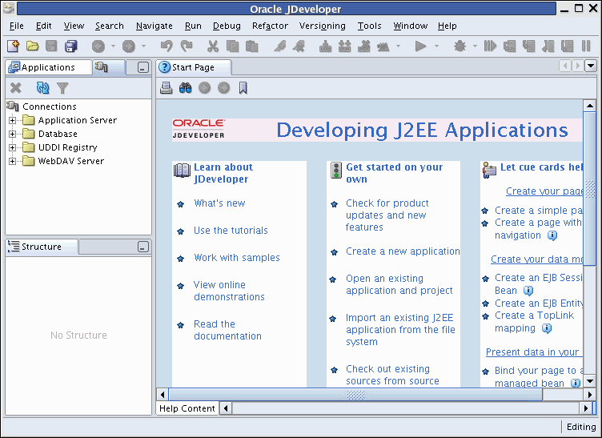
PL/SQL Programming Environments
Oracle JDeveloper
Notes:
Oracle Database 10g: PL/SQL Fundamentals 1 - <number>
PL/SQL Programming Environments
Oracle JDeveloper: An integrated development environment (IDE) that provides end-to-end support for building, testing, and deploying J2EE applications, Web services, and PL/SQL.
You can use Oracle JDeveloper to do the following:
Establish connection to the database with a user-friendly wizard
Browse through the objects in the database you are connected to
Create database users and objects
Create, run, and debug PL/SQL programs such as procedures, functions, and packages
Note: You can use both Oracle JDeveloper and Oracle SQL Developer as programming environments. However, this course uses Oracle SQL Developer for all demonstrations and practices.

Slide 16
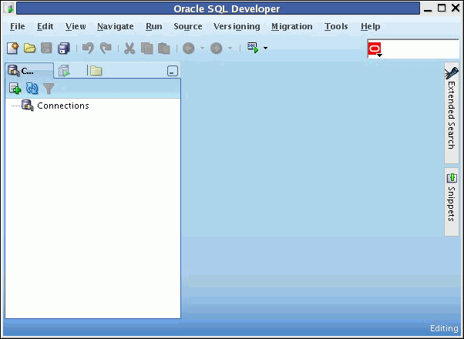
PL/SQL Programming Environments
Oracle SQL Developer
Notes:
Oracle Database 10g: PL/SQL Fundamentals 1 - <number>
PL/SQL Programming Environments (continued)
Oracle SQL Developer: Developed in Java, the tool runs on Windows, Linux, and Mac operating system (OS) X platforms. You can install SQL Developer on the database server and connect remotely from your desktop, thus avoiding client/server network traffic.
Default connectivity to the database is through the Java Database Connectivity (JDBC) Thin driver, so no Oracle home is required. SQL Developer does not require an installer and you need to simply unzip the downloaded file.

Slide 17
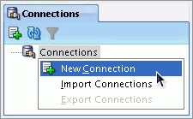
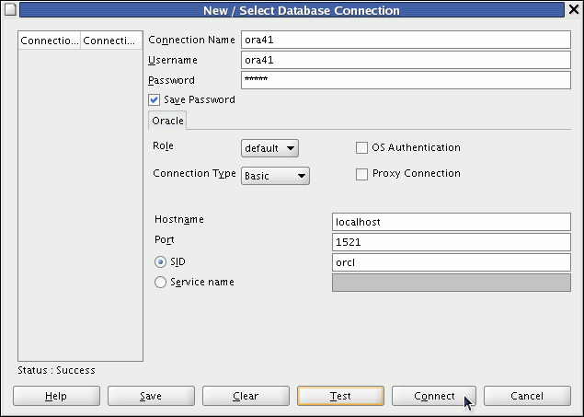
Creating a Database Connection
Notes:
Oracle Database 10g: PL/SQL Fundamentals 1 - <number>
Creating a Database Connection
You must have at least one database connection to use SQL Developer.
To create a database connection, perform the following steps:
1. Double-click <your_path>\sqldeveloper\sqldeveloper.exe.
2. On the Connections tabbed page, right-click Connections and select New Connection.
3. Enter the connection name, username, password, host name, port number, and SID for the database you want to connect.
4. Click Test to make sure that the connection has been set correctly.
5. Click Connect.
Note: If you select the Save Password check box, the password is saved to an XML file. So, after you close the SQL Developer connection and open it again, you will not be prompted for the password.
After you create a database connection, a SQL Worksheet for that connection automatically opens. For more information about Oracle SQL Developer, refer to Appendix E “Using SQL Developer.”

Slide 18
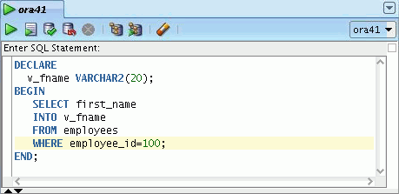
Creating an Anonymous Block
Enter the anonymous block in the SQL Developer workspace:
Notes:
Oracle Database 10g: PL/SQL Fundamentals 1 - <number>
Creating an Anonymous Block
To create an anonymous block by using SQL Developer, enter the block in the SQL Worksheet (as shown in the slide). The block has the declarative section and the executable section. You need not pay attention to the syntax of the statements in the block; you will learn the syntax later in the course. The anonymous block gets the first_name of the employee whose employee_id is 100 and stores it in a variable called v_fname.

Slide 19
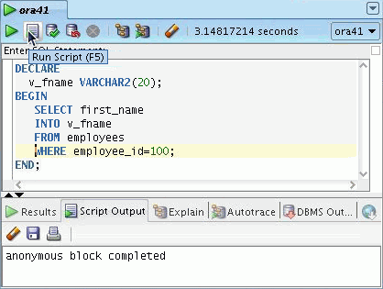
Executing an Anonymous Block
Click the Run Script button to execute the anonymous block:
Notes:
Oracle Database 10g: PL/SQL Fundamentals 1 - <number>
Executing an Anonymous Block
Click the Run Script button to execute the anonymous block in the workspace. Note that the message “anonymous block completed” is displayed in the Script Output window after the block is executed.

Slide 20
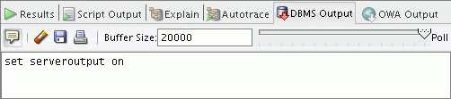
Testing the Output of a PL/SQL Block
  Enable output in SQL Developer by clicking the Enable DBMS Output button on the DBMS Output tab:
  Use a predefined Oracle package and its procedure:
    DBMS_OUTPUT.PUT_LINE
Enable DBMS Output
DBMS Output Tab
Notes:
Oracle Database 10g: PL/SQL Fundamentals 1 - <number>
Testing the Output of a PL/SQL Block
In the example shown in the previous slide, a value is stored in the v_fname variable. However, the value has not been printed. You now learn how to print the value.
PL/SQL does not have built-in input or output functionality. Therefore, you need to use predefined Oracle packages for input and output. To generate output, you must:
Enable output in SQL Developer by clicking the Enable Output button on the DBMS Output tab. This will, in turn, execute the SET SERVEROUTPUT ON command, which is displayed in the window. To enable output in SQL*Plus, you must explicitly issue the SET SERVEROUTPUT ON command.
Note: You can still use the SET SERVEROUTPUT ON SQL*Plus command and view the output in the Script tab. The course code examples uses the SET SERVEROUTPUT ON SQL*Plus command.
Use the PUT_LINE procedure of the DBMS_OUTPUT package to display the output. Pass the value that has to be printed as argument to this procedure (as shown in the slide). The procedure then outputs the argument.

Slide 21
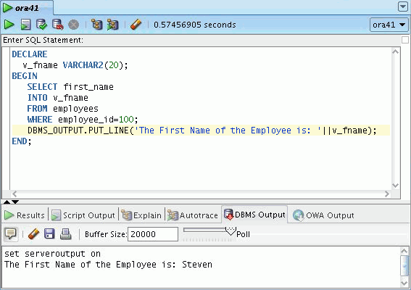
Testing the Output of a PL/SQL Block
Notes:
Oracle Database 10g: PL/SQL Fundamentals 1 - <number>
Testing the Output of a PL/SQL Block (continued)
The slide shows the output of the PL/SQL block after the inclusion of the code for generating output.

Slide 22
Summary
In this lesson, you should have learned how to:
  Integrate SQL statements with PL/SQL program constructs
  Identify the benefits of PL/SQL
  Differentiate different PL/SQL block types
  Use Oracle SQL Developer as the programming environment for PL/SQL
  Output messages in PL/SQL
Notes:
Oracle Database 10g: PL/SQL Fundamentals 1 - <number>
Summary
PL/SQL is a language that has programming features that serve as an extension to SQL. SQL, which is a nonprocedural language, is made procedural with PL/SQL programming constructs. PL/SQL applications can run on any platform or operating system on which an Oracle server runs. In this lesson, you learned how to build basic PL/SQL blocks.

